Slide 1
AWS Sagemaker Edge Agent as Synthetic Pelion Edge Subordinate Device
Doug Anson

Slide 2
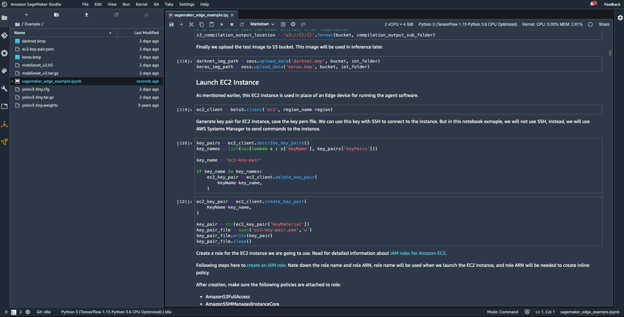
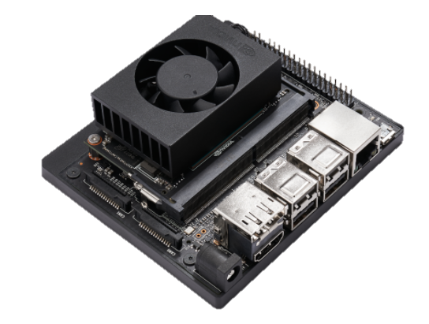
Overview
Pelion
Pelion Edge enabled NX Xavier
Sagemaker Edge Agent installed
Edge PT coordinates between Agent and Edge via Pelion
AWS Sagemaker™ Edge Agent Manager
AWS Sagemaker™
Data Scientist utilizes AWS Sagemaker to construct and train ML models
Then, the Data Scientist compiles and deploys the model down to a Pelion Edge (Nvidia Jetson NX Xavier) enabled gateway to execute and gather results
Results are delivered back into the Data Scientist’s notebook for more training/evaluation via integration with Pelion

Slide 3
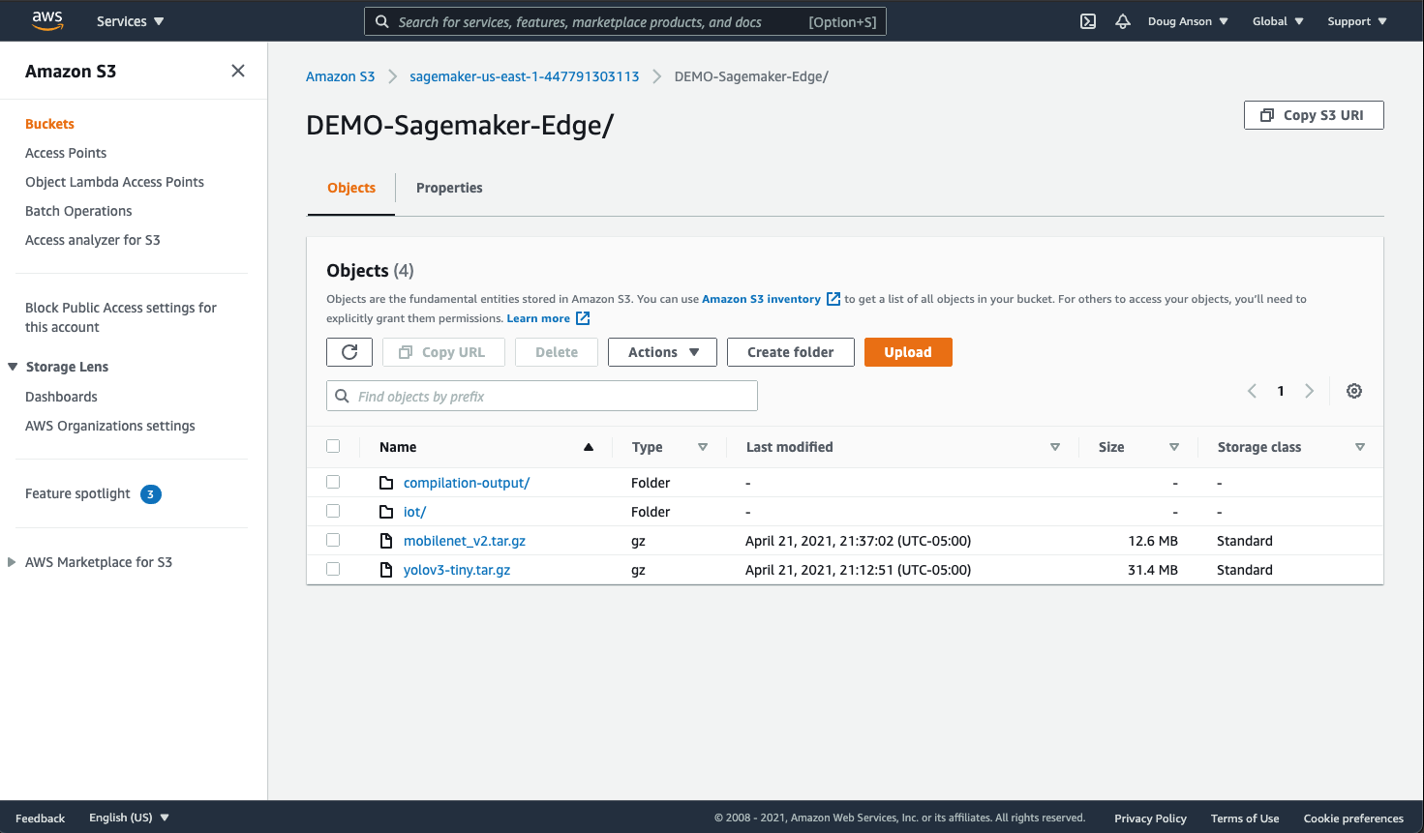
What is AWS Sagemaker?
AWS Web Service that hosts Jupyter notebooks for ML development
Provides many features for optimized compiling of models to targeted platforms (Jetson is one of many of them…)
Integrated with AWS S3
“Sagemaker Edge Agent Manager” is an edge deployment agent that can run Sagemaker compiled models – but it does not require AWS IoTCore for the deployment plumbing…

Slide 4
Controlling Sagemaker Edge Agent via Pelion Edge
Main integration concepts
Create a Pelion Edge PT subordinate device that represents a running Sagemaker Edge Agent Manager instance
Craft LWM2M resources in our device’s PT that provide a JsonRPC v2.0 call interface with the agent being represented
Provide S3 and local filesystem integration compiled model downloading from Sagemaker and for prediction results uploading back to Sagemaker
The device PT is deployed as a Kubernetes container via Pelion down to the Xavier Edge gateway

Slide 5


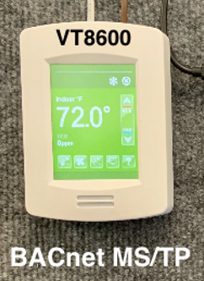

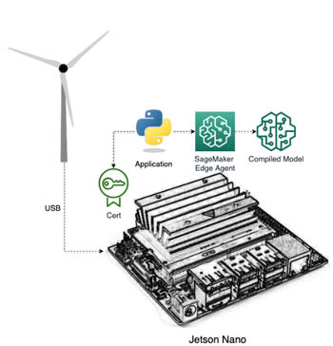
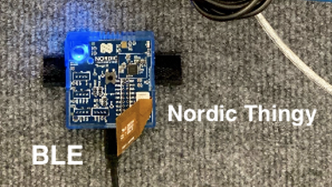
Sagemaker Edge Agent PT in Pelion Edge
REST over HTTPS / WSS
Pelion Device Management
Pelion Portal
HTTPS / WSS
My MacBook running Sagemaker notebook using Pelion Rest APIs
Edge Proxy
HTTP
Parsec
Edge Core
Maestro
Fluentbit
Kubelet
Pelion Edge Gateway
Local device management bus (DM-Bus) PT APIs
JSON-RPC WS
Other App Container
Container 2 (Blinker)
AWS Sagemaker Edge Agent Manager On Pelion Edge GW
TPM or SE
BACnet PT
BLE Device PT
Sagemaker-Edge-Agent
PT
Container
RS485
Wireless 2.4 GHz
gRPC

Slide 6
Currently Supported Commands
List Downloaded Models in Sagemaker Edge Agent:
{"jsonrpc":"2.0","id":"1","method":"listModels"}
Download a Sagemaker compiled model into Sagemaker Edge Agent, then load it:
{"jsonrpc":"2.0","id":"1","method":"loadModel","params":{"name":"demo-keras","s3_filename":"keras-model-1.0.tar.gz"}}
Unload a model from the Sagemaker Edge Agent:
{"jsonrpc":"2.0","id":"1","method":"unloadModel","params":{"name":"demo-keras"}}
Reload a Sagemaker compiled model into Sagemaker Edge Agent:
{"jsonrpc":"2.0","id":"1","method":”reloadModel","params":{"name":"demo-keras","s3_filename":"keras-model-1.0.tar.gz"}}
Perform a prediction using the specified input data, optionally placing the prediction output to the specified output location :
{"jsonrpc":"2.0","id":"1","method":"predict",
"params":{"model_name":"demo-keras","input_data_url":"s3:///input-tensor.data","output_url":"s3:///output-tensor.data"}}

Slide 7
Demos and Q/A
Thanks!!

Slide 8

Sagemaker Edge Agent PT Container: Deployment via Pelion Kubernetes
Pelion
Pod Dispatched/Run via Pelion Kubelet
Pod “Create”
Jetson Xavier NX Platform
Pelion Kubelet
Sagemaker Edge Agent Container
Sagemaker Edge Agent Service
Sagemaker Edge Agent Protocol Translator
Pelion User uses Pelion integrated “kubectl” to create and run the Edge Agent Container on the Xavier Edge gateway
Pelion then dispatches the download and creation/run of the requested Pod via Pelion-integrated Kubelet on the Xavier Edge gateway
Edge Agent Container invokes an instance of AWS Sagemaker Edge Agent and the Edge PT to drive the agent
gRPC
Pelion Edge
NVidia-optimized Docker Runtime
NVidia-optimized Ubuntu 18.04 (L4T)
Xavier NX GPU
Xavier NX CPU

